Slide 1

The Engine of AI: Powering Our Future, Straining Our Planet
Group: IU5-52B
Student: Kudabayeva Evita

Slide 2
Contents:
- Introduction: The Astronomical Bet
- The Journey of a Single Query
- The Immense Environmental Footprint
- The Political and Economic Battleground
- Is This a Bubble Waiting to Burst?
- What Can We Do? Navigating the Shift
- Conclusion: A Defining Gamble

Slide 3

The Engine of AI: Powering Our Future, Straining Our Planet
In the global race to dominate artificial intelligence, tech giants are making astronomical bets. Hundreds of billions of dollars are being poured into the construction of AI data centres—massive warehouses packed with computing hardware. But as this infrastructure boom accelerates, pressing questions about its viability, its massive energy appetite, and its societal impact are coming to the forefront.

Slide 4
The Journey of a Single Query
To truly grasp the scale of AI infrastructure, consider the intricate process that unfolds when you ask a simple question to an AI, such as "What should I make for dinner?" This seemingly instantaneous interaction triggers a complex chain of events across continents.
01
02
03
1. The Request
2. The Breakdown
3. The Hardware
Your query travels over the internet to the AI provider's servers, where it undergoes checks for user authentication and content moderation to ensure safety and compliance.
Your words are then meticulously broken down into smaller chunks of text, known as "tokens"—the fundamental units that AI models are designed to process and understand.
The processed request lands in a data centre, specifically targeting specialised hardware: Graphics Processing Units (GPUs). Unlike standard computer chips, GPUs excel at performing millions of calculations simultaneously, a process called parallel processing.
04
05
4. The "Inference"
5. The Response
The AI model then begins its "inference time," predicting which token should come next, one after another, until it constructs a coherent and contextually relevant answer to your query.
Finally, the completed answer is swiftly transmitted back through the vast network, appearing on your screen in a matter of seconds. This entire complex process is a marvel of modern engineering, yet it carries an immense cost.

Slide 5

The Immense Environmental Footprint
The convenience and instantaneous nature of AI come with a significant and often hidden cost: immense energy consumption. Data centres are power-hungry facilities, demanding vast amounts of electricity not only to run their powerful GPUs but also for essential cooling systems, lighting, and network equipment. Their energy usage often fluctuates, spiking during peak query times and dipping during quieter periods.

Slide 6
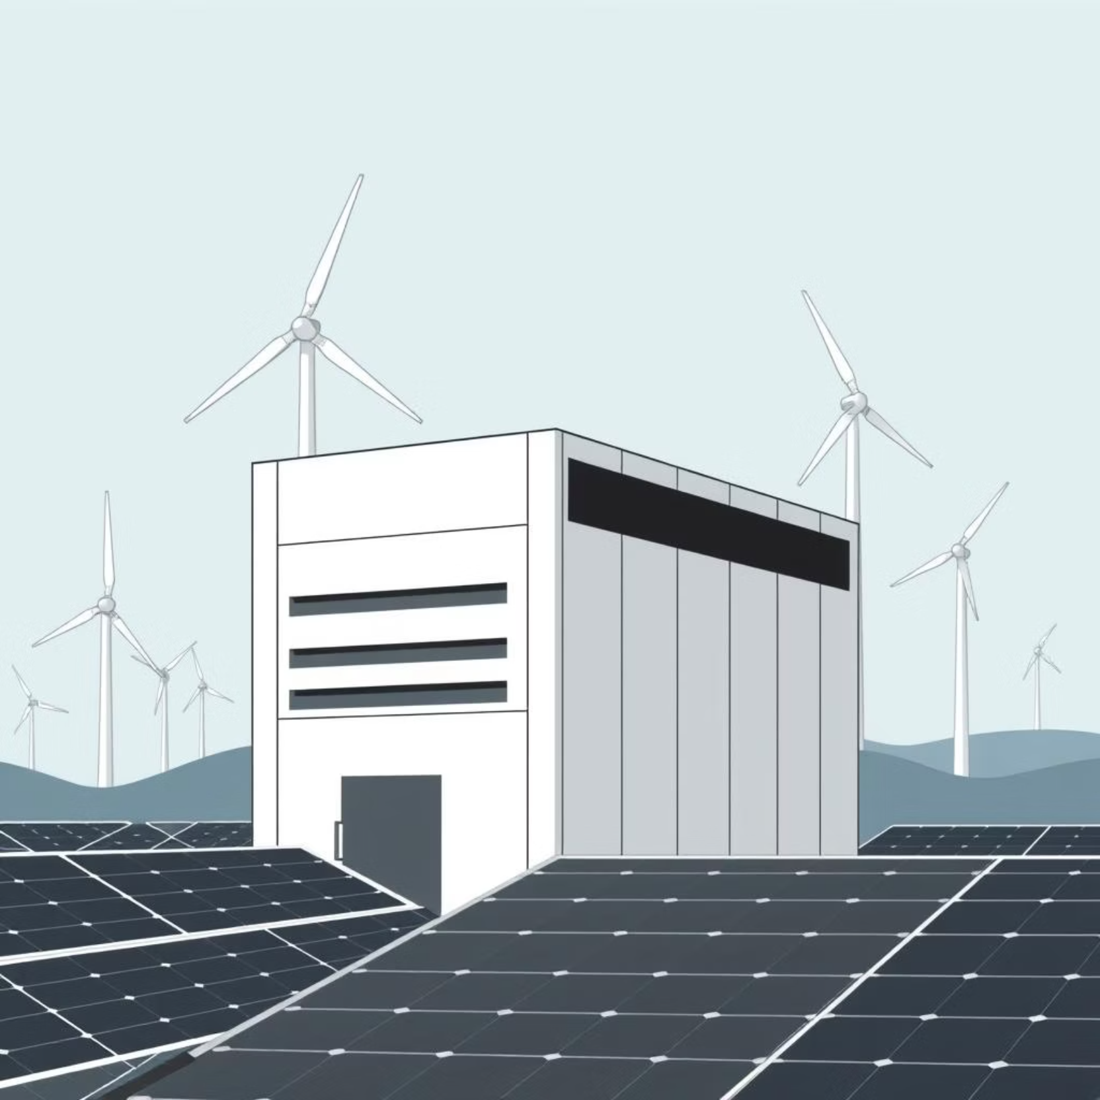
Energy Dependency & Opaque Impacts
The total environmental impact of these facilities is complex and frequently opaque. As climate and energy expert Molly Taft highlights, a data centre's carbon footprint is heavily dependent on the energy grid it's plugged into. A facility powered by renewable sources like solar or wind has a vastly lower impact than one reliant on fossil fuels.
The scale of new projects is staggering. Meta’s planned “Hyperion” data centre in Louisiana, for instance, is projected to require approximately five gigawatts of power—roughly half the peak energy load of an entire city like New York.

Slide 7



A Growing National Concern
Ireland's Consumption
Virginia's Surge
Underreported Emissions
In Ireland, data centres already consume over 20% of the country's total electricity, placing immense strain on national grids.
Virginia, a major hub for data centre development, is facing a similar surge in demand, prompting concerns about energy supply and grid stability.
Furthermore, the energy figures reported by companies often only cover direct power usage, excluding the "embodied emissions" from manufacturing and transporting hardware.
Experts like Sasha Luccioni, climate lead at Hugging Face, have criticised the industry's lack of transparency, calling for standardised, verifiable efficiency metrics to truly understand the environmental cost.

Slide 8
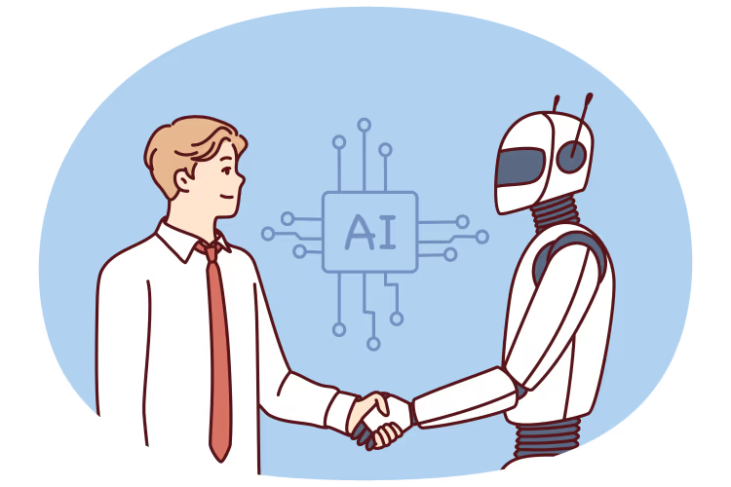
The Political and Economic Battleground
The data centre boom has ignited a fierce political struggle, leading to an unlikely alignment of interests.
On one side, there is strong federal support for building an "American AI empire," often framed as a national priority, pushing for expansion powered by traditional energy sources like oil, gas, and nuclear.

Slide 9
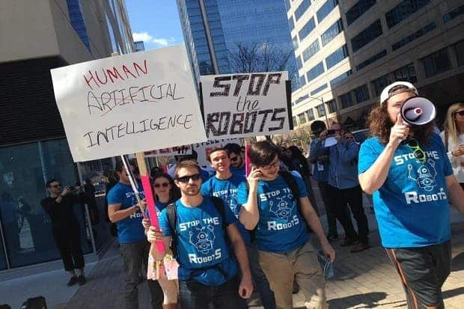
Local Pushback & Unlikely Alliances
On the other side, grassroots opposition is growing rapidly in local communities. Concerns range from fears of skyrocketing electricity rates and excessive water usage for cooling to noise pollution and diminished air quality.
A notable example occurred in Memphis, where Elon Musk's xAI installed unpermitted gas turbines in a majority-Black community already burdened with pollution. The local pushback was swift and powerful, showcasing the rising public scrutiny.
This contrast has even brought together unlikely political allies, from progressive environmental activists to figures like Marjorie Taylor Greene, who has publicly expressed fears about AI, comparing it to the fictional "Skynet."

Slide 10

Is This an AI Bubble Waiting to Burst?
With such massive investment, a critical question remains: is this expansion sustainable, or is it an AI bubble? The fundamental issue is a potential mismatch between supply and demand.
Tech companies are investing hundreds of billions in infrastructure under the assumption that consumer and enterprise demand for AI will continue to scale infinitely. However, current revenue, particularly from everyday consumers, has not yet caught up to the level of investment. Much of the income for AI companies currently comes from enterprise developers, not the general public.

Slide 11
Technological Obsolescence & Emerging Alternatives
Risk of Obsolescence
Smaller, Efficient Models
The current model of building ever-larger models requiring more powerful GPUs may not last. Today's massive, fixed investments could become less competitive.
Research into smaller, more efficient models and novel chip designs offers a pathway to less resource-intensive AI, challenging the scale-at-all-costs approach.
Alternative Computing
Low-Cost Competition
Alternative computing methods like quantum computing could fundamentally alter the landscape, rendering current infrastructure paradigms obsolete.
The emergence of low-cost models, such as DeepSeek from China, serves as an early warning that the path to advanced AI may not solely be through sheer computational size.

Slide 12



What Can We Do?
Faced with such a large-scale technological shift, individuals may feel powerless, but there are meaningful ways to engage:
Understand Your Local Utility
Double-Down on the Humanities
Engage Critically with Technology
The impact of a data centre on your community, especially electricity rates, is often mediated through your local utility. Learn how these companies operate and support groups advocating for renewable energy and fair rates.
While AI is not disappearing, nurturing uniquely human skills—critical thinking, creativity, and personal relationships—becomes even more valuable. Engage with human-generated art, literature, and conversation.
To form an informed opinion, understand the technology. Dabble with AI tools, but be a critical user. Avoid treating them as sentient beings, and push back against AI features added where they offer no real utility.
The AI data centre boom is a defining phenomenon of our time, representing a colossal gamble on the future of technology and its role in our society. Understanding how these facilities work, the resources they consume, and the forces driving their expansion is the first step toward navigating the world they are building.

Slide 13
Conclusion:
The AI data center boom represents a colossal gamble on our technological and societal future.
Key Takeaways:
AI's "convenience" is powered by a vast, resource-intensive physical infrastructure, with a
complex and often hidden environmental cost.
This expansion has ignited a political struggle, creating friction between national ambitions and local
community welfare.
Current breakneck investment faces fundamental questions about economic sustainability and
technological longevity.
We stand at a crossroads. The path forward requires moving from passive consumption to informed
engagement:
Demand Transparency & Responsibility from companies and utilities on energy use and community impact.
Champion Human-Centric Values in a world increasingly shaped by synthetic intelligence.
Make Conscious Choices as users, voters, and community members to shape the trajectory of this
powerful technology.
The story of AI will be written not just in code, but in policy, watts, and water. Understanding
this engine is the first step toward ensuring it powers a future that is sustainable, equitable, and truly intelligent.

Slide 14
Sources:
AI’s Growing Energy Footprint (The Atlantic)
https://www.theatlantic.com/technology/archive/2023/10/ai-energy-consumption-google-microsoft-openai/675747/
Molly Taft's article detailing the immense and often opaque electricity demands of the AI boom.
Data Centres and Data Transmission Networks (International Energy Agency)
https://www.iea.org/energy-system/buildings/data-centres-and-data-transmission-networks
The IEA's authoritative tracking and analysis of global data center energy use, trends, and efficiency.
The U.S. Is Spending Billions on AI. Local Communities Are Paying the Price. (The Wall Street Journal)
https://www.wsj.com/tech/ai/ai-data-centers-power-local-communities-0f12f6c2
A detailed report on the political and community-level conflicts sparked by data center expansion.
AI’s new wave of ‘small’ models (Financial Times)
https://www.ft.com/content/a94ffa6f-6dd9-4e93-8f7d-263c3e5c8d4f
Analysis on efficient, low-cost models like DeepSeek that challenge the "bigger is better" paradigm.
Measuring the Carbon Footprint of AI Models (Hugging Face Blog)
https://huggingface.co/blog/llm-environmental-impact
Sasha Luccioni's work on transparency and tools for measuring the environmental impact of AI, including embodied emissions.
The Coming AI Bubble (The Economist)
https://www.economist.com/leaders/2024/03/27/the-coming-ai-bubble
A critical look at the massive investments in AI infrastructure and the potential economic sustainability crisis.
How ChatGPT Works (Visual Capitalist)
https://www.visualcapitalist.com/how-chatgpt-works-visualizing-ai-architectures/
An accessible, visual explainer of the process from query to response, useful for explaining the "Journey of a Single Query."

